Slide 1
Chapter 3
Data Modeling Using the Entity-Relationship (ER) Model

Slide 2
Chapter Outline
Example Database Application (COMPANY)
ER Model Concepts
  Entities and Attributes
  Entity Types, Value Sets, and Key Attributes
  Relationships and Relationship Types
  Weak Entity Types
  Roles and Attributes in Relationship Types
ER Diagrams - Notation
ER Diagram for COMPANY Schema
Alternative Notations – UML class diagrams, others
Chapter 3-<number>

Slide 3
Outline of Database Design
Requirements Collection and Analysis: purpose is to produce a description of the users' requirements.
Conceptual Design: purpose is to produce a conceptual schema for the database, including detailed descriptions of entity types, relationship types, and constraints.
Implementation: purpose is to transform the conceptual schema into a representational/implementational model supported by whatever DBMS is to be used.
Physical Design: purpose is to decide upon the internal storage structures, access paths (indexes), etc., that will be used in realizing the representational model produced in previous phase.
In addition with these, application programs are designed and implemented as database transaction corresponding to the high level transaction specification
Chapter 3-<number>

Slide 4
ER Model Concepts
Entities and Attributes
- The basic object the ER model represents is an ENTITY
  Entities are specific objects or things in the mini-world that are represented in the database. For example the EMPLOYEE John Smith, the Research DEPARTMENT, the ProductX PROJECT
  Attributes are properties used to describe an entity. For example an EMPLOYEE entity may have a Name, SSN, Address, Sex, BirthDate
  A specific entity will have a value for each of its attributes. For example a specific employee entity may have Name='John Smith', SSN='123456789', Address ='731, Fondren, Houston, TX', Sex='M', BirthDate='09-JAN-55‘
  Each attribute has a value set (or data type) associated with it – e.g. integer, string, subrange, enumerated type, …
Chapter 3-<number>

Slide 5
Cont..
Types of Attributes:
  • Simple (Atomic) Vs. Composite
  • Single Valued Vs. Multi Valued
  • Stored Vs. Derived
  • Null Values
Chapter 3-<number>

Slide 6
Cont..
Simple Vs. Composite Attribute:
● Simple
  Attribute that are not divisible are called simple or atomic attribute.
  For example, Age, Sex
● Composite
  The attribute may be composed of several components.
  For example, Address (Apt#, House#, Street, City,
  State, ZipCode, Country)
or
Name (FirstName, MiddleName, LastName).
Composition may form a hierarchy and some components are themselves composite.
Chapter 3-<number>

Slide 7
single Valued Vs. Multi Valued
● Single Valued
An attribute having only one value.
For example, Age, Date of birth, Sex, SSN
● Multi-valued
An entity may have multiple values for that attribute.
For example, Color of a CAR or Previous Degrees of a
STUDENT.
Denoted as {Color} or {PreviousDegrees}.
Phone number of an employee.
Chapter 3-<number>

Slide 8
Stored Vs. Derived
In some cases two are more attributes values are related
For example the age and date of birth of a person.
For a particular person entity, the value of age can be determined from the current (todays) date.
The Age attribute is hence called a derived attribute and
is said to be derivable from the Birthdate attribute , which
is called stored attribute.
Chapter 3-<number>

Slide 9
Cont..
Null Values
In some cases a particular entity may not have an
applicable value for an attribute. For example, a college
degree attribute applies only to persons with college degrees.
For such situation, a special value called null is created.
Chapter 3-<number>

Slide 10
Cont..
Entity types : A entity type defines a set of entities that have the same attribute
Entity sets : A collection of all entities of a particular entity type in the database at any point in time is called an entity set.
Chapter 3-<number>

Slide 11
ENTITY SET corresponding to the
ENTITY TYPE CAR
CAR
Registration(RegistrationNumber, State), VehicleID, Make, Model, Year, (Color)
car₁
((ABC 123, TEXAS), TK629, Ford Mustang, convertible, 1999, (red, black))
car₂
((ABC 123, NEW YORK), WP9872, Nissan 300ZX, 2-door, 2002, (blue))
car₃
((VSY 720, TEXAS), TD729, Buick LeSabre, 4-door, 2003, (white, blue))
.
.
.
Chapter 3-<number>

Slide 12
Entity Types and Key Attributes
Entities with the same basic attributes are grouped or typed into an entity type. For example, the EMPLOYEE entity type or the PROJECT entity type.
An attribute of an entity type for which each entity must have a unique value is called a key attribute of the entity type. For example, SSN of EMPLOYEE.
A key attribute may be composite. For example, VehicleTagNumber is a key of the CAR entity type with components (Number, State).
An entity type may have more than one key. For example, the CAR entity type may have two keys:
Employee is identified with Employee Id and Adhar No
Chapter 3-<number>

Slide 13
Relationships and Relationship Types (1)
An attribute of one entity type refers to another entity type, some relationship exists
A relationship relates two or more distinct entities with a specific meaning. For example, EMPLOYEE John Smith works on the ProductX PROJECT or EMPLOYEE Franklin Wong manages the Research DEPARTMENT.
Relationships of the same type are grouped or typed into a relationship type. For example, the WORKS_ON relationship type in which EMPLOYEEs and PROJECTs participate, or the MANAGES relationship type in which EMPLOYEEs and DEPARTMENTs participate.
Chapter 3-<number>

Slide 14
Relationships of Higher Degree
The degree of a relationship type is the number of participating entity types.
Relationship types of degree 2 are called binary
Relationship types of degree 3 are called ternary and of degree n are called n-ary
In general, an n-ary relationship is not equivalent to n binary relationships
Chapter 3-<number>

Slide 15
Weak Entity Types
An entity that does not have a key attribute
A weak entity must participate in an identifying relationship type with an owner or identifying entity type
Entities are identified by the combination of:
  A partial key of the weak entity type
  The particular entity they are related to in the identifying entity type
Example:
Suppose that a DEPENDENT entity is identified by the dependent’s first name and birhtdate, and the specific EMPLOYEE that the dependent is related to. DEPENDENT is a weak entity type with EMPLOYEE as its identifying entity type via the identifying relationship type DEPENDENT_OF
Chapter 3-<number>

Slide 16
Constraints on Relationships
Constraints on Relationship Types
  ( Also known as ratio constraints )
  Maximum Cardinality
    One-to-one (1:1)
    One-to-many (1:N) or Many-to-one (N:1)
    Many-to-many
  Minimum Cardinality (also called participation constraint or existence dependency constraints)
    zero (optional participation, not existence-dependent)
    one or more (mandatory, existence-dependent)
Chapter 3-<number>

Slide 17
Many-to-one (N:1) RELATIONSHIP
EMPLOYEE
WORKS_FOR
DEPARTMENT
e_{1 }
e_{2 }
e_{3 }
e_{4 }
e_{5 }
e_{6 }
e_{7 }
r₁
r₂
r₃
r₄
r₅
r₆
r₇
● d₁
● d₂
● d₃
Chapter 3-<number>

Slide 18
Many-to-many (M:N) RELATIONSHIP
e_{1 }
e_{2 }
e_{3 }
e_{4 }
e_{5 }
e_{6 }
e_{7 }
r₉
r₁
r₂
r₃
r₄
r₅
r₆
r₇
● p₁
● p₂
● p₃
r₈
Chapter 3-<number>

Slide 19
Relationships and Relationship Types (3)
We can also have a recursive relationship type.
Both participations are same entity type in different roles.
For example, SUPERVISION relationships between EMPLOYEE (in role of supervisor or boss) and (another) EMPLOYEE (in role of subordinate or worker).
In following figure, first role participation labeled with 1 and second role participation labeled with 2.
In ER diagram, need to display role names to distinguish participations.
Chapter 3-<number>

Slide 20
A RECURSIVE RELATIONSHIP
SUPERVISION
EMPLOYEE
SUPERVISION
e_{1 }
e_{2 }
e_{3 }
e_{4 }
e_{5 }
e_{6 }
e_{7 }
r₁
r₂
r₃
r₄
r₅
r₆
2
1
1
2
2
1
2
1
1
2
1
2
© The Benjamin/Cummings Publishing Company, Inc. 1994, Elmasri/Navathe, Fundamentals of Database Systems, Second Edition
Chapter 3-<number>

Slide 21
Attributes of Relationship types
A relationship type can have attributes; for example, HoursPerWeek of WORKS_ON; its value for each relationship instance describes the number of hours per week that an EMPLOYEE works on a PROJECT.
Chapter 3-<number>

Slide 22
Structural Constraints – one way to express semantics of relationships
Structural constraints on relationships:
Cardinality ratio (of a binary relationship):
Specify the number of relationship instances that an entity can participate in.
cordinality ratio 1:1, 1:N, N:1, or M:N
Chapter 3-<number>

Slide 23
Cont..
Participation constraint :.Specify whether the existence of an entity depends on its being related to another entity via the relationship.
Total participation : It specifies that each entity present in the entity set must mandatorily participate in at least one relationship instance of that relationship set, for this reason, it is also called as mandatory participation EX : Every employee must work for Department
Partial Participation : specifies that each entity in the entity set may or may not participate in the relationship instance in that relationship set. That is why, it is also called as optional participation. Partial participation is represented using a single line between the entity set and relationship set. Ex : WE do not expect every employee to manage department.
Chapter 3-<number>

Slide 24
SUMMARY OF ER-DIAGRAM
NOTATION FOR ER SCHEMAS
Symbol
Meaning
ENTITY TYPE
WEAK ENTITY TYPE
RELATIONSHIP TYPE
IDENTIFYING RELATIONSHIP TYPE
ATTRIBUTE
KEY ATTRIBUTE
MULTIVALUED ATTRIBUTE
COMPOSITE ATTRIBUTE
DERIVED ATTRIBUTE
TOTAL PARTICIPATION OF E₂ IN R
CARDINALITY RATIO 1:N FOR E₁:E₂ IN R
STRUCTURAL CONSTRAINT (min, max) ON PARTICIPATION OF E IN R
E₁
R
E₂
E₁
R
N
E₂
R
(min,max)
E
Chapter 3-<number>

Slide 25
Example COMPANY Database
Requirements of the Company (oversimplified for illustrative purposes)
  The company is organized into DEPARTMENTs. Each department has a name, number and an employee who manages the department. We keep track of the start date of the department manager.
  Department is located at multiple location.
  Each department controls a number of PROJECTs. Each project has a name, number and is located at a single location.
Chapter 3-<number>

Slide 26
Example COMPANY Database (Cont.)
  We store each EMPLOYEE’s social security number, address, salary, sex, and birthdate. Each employee works for one department but may work on several projects. We keep track of the number of hours per week that an employee currently works on each project. We also keep track of the direct supervisor of each employee.
  Each employee may have a number of DEPENDENTs. For each dependent, we keep track of their name, sex, birthdate, and relationship to employee.
Chapter 3-<number>

Slide 27
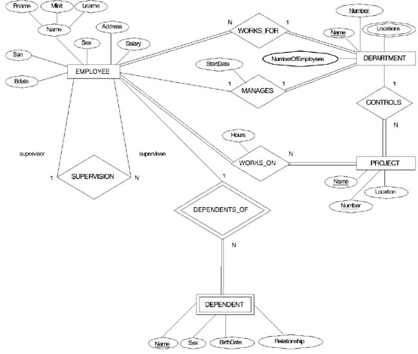
Cont..
Chapter 3-<number>

Slide 28
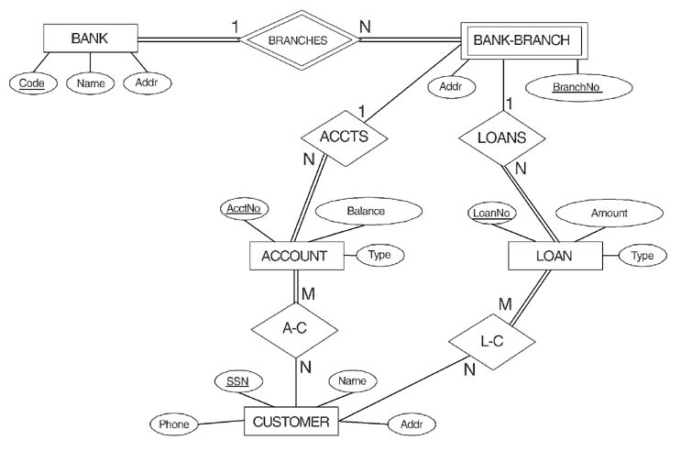
ER DIAGRAM FOR A BANK
DATABASE
Chapter 3-<number>

Slide 29
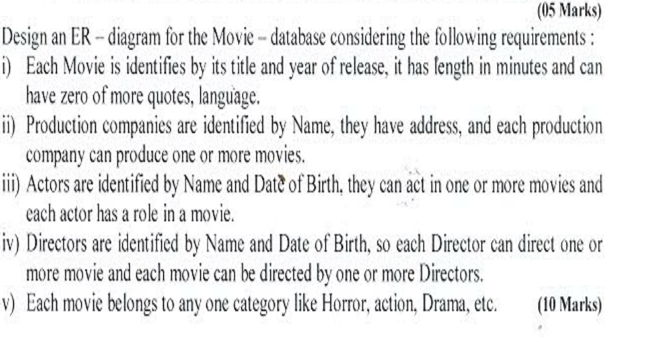
Chapter 3-<number>

Slide 30
PROBLEM with ER notation
THE ENTITY RELATIONSHIP MODEL IN ITS ORIGINAL FORM DID NOT SUPPORT THE SPECIALIZATION/ GENERALIZATION ABSTRACTIONS
Chapter 3-<number>

